Slide 1
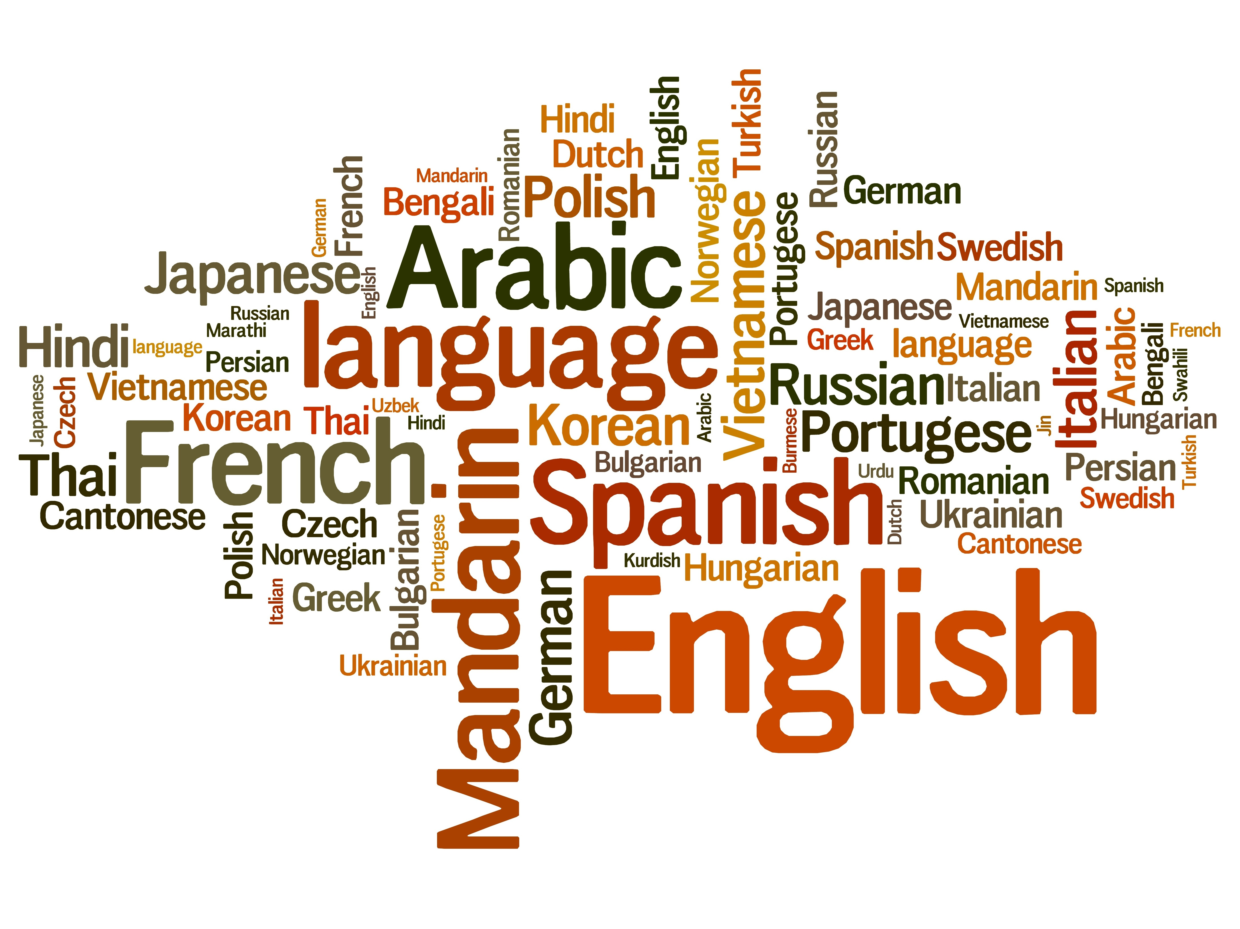
Dive Deeper into Present-Day English
Vol.5 -Hidden Feature of Language-
Composed By: Hayato Ishida
For Japanese version, click here
Updated On: 16 July 2024

Slide 2
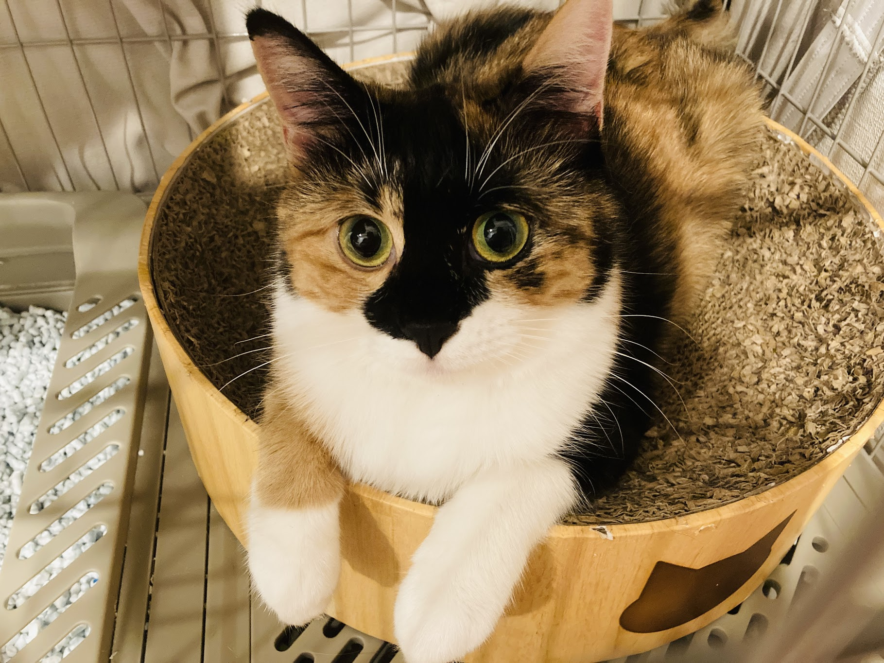
About Me
Accounts
GitHub: @hayat01sh1da
X: @hayat01sh1da
LinkedIn: @hayat01sh1da
Speaker Deck: @hayat01sh1da
Docswell: @hayat01sh1da
Occupation: Software Engineer
Things I Am Into
Linguistics
Singing at Karaoke
Listening to Music
Watching Movies
Cat Feeding

Slide 3
Licences / Certifications
English
TOEIC® Listening & Reading 915: Certified on December 2019
Engineering
Information Security Management: Certified on November 2017
Applied Information Technology Engineer: Certified on June 2017
Fundamental Information Technology Engineer: Certified on November 2016
IT Passport: Certified on April 2016
Others
Abacus 2nd Class: Certified on June 2002
Mental Arithmetic 3rd Class: Certified on February 2001

Slide 4
Skill Stack
Languages
Japanese: Native Proficiency
English: Full professional Proficiency
Development
Backend: Ruby(Ruby on Rails), Python
Frontend: TypeScript + React.js, TypeScript +Vue.js
Database: MySQL, PostgreSQL, MongoDB
Architecture: Monolith, Modular Monolith
Hosting: AWS ESK
Versioning: Git, GitHub
CI/CD: GitHub Actions, ArgoCD
Monitoring: Datadog, Sentry

Slide 5
Work Histories
Period | Genre | Position | Jobs
Aug 2021 - Present | Saas(Educational Service) | Software Engineer | Backend Development Frontend Development CI/CD Maintenance Weekly Release Manager Troubleshooting Documentation Technical Debt Resolution Tech Blog Entries LT Speaker
Feb 2020 - Dec 2020 | SaaS(Chatbot Platform) | Backend Engineer | Backend Development Documentation Technical Debt Resolution Inspection of Alternative API

Slide 6
Work Histories
Period | Genre | Position | Jobs
Jun 2018 - Jan 2020 | Contract-basis Developer | Software Engineer | Backend Development Frontend Development Troubleshooting Quality Assurance Tech Blog Entries
Apr 2016 - Jan 2018 | System Engineering Service | System Engineer | Corporate Account Admin Windows Server Maintenance Security Admin Assistant Internationalisation / Localisation

Slide 7
International-Exchange Activities
Activities in University
English Linguistics Seminar(Focusing on Mass Media English)
International-Exchange Clubs(The 2nd Year)
International-Exchange Programmes conducted by Japan Cabinet Office(2013 - 2016)
Japanese Linguistics Course(The Final Year)
Overseas Life Experience
Working Holiday in Australia(April 2014 - March 2015)
Language School for 1 month in Sydney
Work for 6 Months in Hamilton Island Resort
Volunteering for 1 Month as Assistant Teacher of Japanese Language at St Ives High School in NSW
Other Activities
Keep Everyday Journal in English (April 2014 - Present)
Sunrise Toastmasters Club(February 2017 - March 2018)
Vital Japan(January 2018 - July 2019, October 2022 - February 2023)
Self Learning and Training of English Language
Participation Ruby-Related Tech Conferences

Slide 8
Goals of This Series
To know how deep English Language is
Not simply a communication tool
To know your own language by knowing another
"He who knows no foreign languages knows nothing of his own." by Johann Wolfgang von Goethe
To pursue the essence that does not instantly but work later on
Something which you think is meaningless has something genuine

Slide 9
Agenda
Language Is a Culture
Language Is a Dress Code
Summary
Wrap-Up of This Series
References

Slide 10
1. Language Is a Culture

Slide 11
1. Language Is a Culture
Quote
How we address others depends on our relationships to them. My friends refer to
me as Mike. However, many students refer to me as Prof. Geis or Dr. Geis or Mr. Geis, even though I usually encourage them to call me Mike. Some other American professors encourage this in order to signal a feeling of solidarity with students.
Nevertheless, the power difference between professors and students is large and many students feel more comfortable using a title plus the last name than just the first name. Oriental students who study in the United States normally feel very uncomfortable using just a professor's first name, at least at the beginning.
Reference: p.51 ll.10 - 20, Michael L. Geis, Language and Communication

Slide 12
1. Language Is a Culture
Top 4 Factors to Determine How You Address The Other
Closeness
Age
Social Status
Respect

Slide 13
1. Language Is a Culture
The Difference of Politeness between Western and Eastern Cultures
Western Cultures
To show friendliness
Solidarity brings a psychological safety and boosts productivity via intense collaboration
→ The other lets you call him/her in the first name to lower a psychological hurdle.
Eastern Cultures
To keep the best psychological distance
Japanese language expresses the concept via exalted, humble and polite terms.
→ We maintain a strain relation with the other with a careful language.

Slide 14
1. Language Is a Culture
How Asians Adapt to the Western Culture
Phase 1: Psychological Conflict between the Western and their Own Cultures
Politeness: To show friendliness vs. To keep the best psychological distance
Particularly, Asians think of calling someone superior without title as a rude behaviour.
Phase 2: Acquisition of the Western Language
Experience the western culture via the language
Language conflicts = Cultural conflicts fill the gaps.
Phase 3: Adaptation to the Western Culture
Receive cardiac output of the cultural differences
Reflect the understanding to the language and speech
→ Hesitation to call someone else in their first name will be gone.
Acquisition and Adaptation of the language and culture rebuild their identities.

Slide 15
2. Language Is a Dress Code

Slide 16
2. Language Is a Dress Code
Quote
When we go to a formal social gatherings, we normally wear more expensive and less comfortable clothes than when we plan to meet with close friends. While with friends, we wear clothes that are less expensive and more comfortable.
(snip) By wearing expensive clothes at formal gatherings, we show respect to those that we are with. By wearing less expensive, more comfortable clothes while with friends, we show solidarity with them.
(snip) The same is true of how we talk. By using more formal speech styles in more social gathering, we show respect to our listeners. By using less formal speech styles with our friends and intimates, we show solidarity with them.
Reference: p.59 - 60 ll.25 - 18, Michael L. Geis, Language and Communication

Slide 17
2. Language Is a Dress Code
Quote
(snip) How we talk reflects the social contexts we are in, and in casual speech contexts, not only we are free to use more casual forms, we must use them. Close friends might think we are playing a joke if we were to wear a tuxedo to an
informal party. Similarly, if we were to use precise, careful speech with close friends, they would also think that we are playing a joke of some sort.
Reference: p.59 - 60 ll.25 - 18, Michael L. Geis, Language and Communication

Slide 18
2. Language Is a Dress Code
4 Types of Speech Styles
Speech Styles | Social Situations
Formal speech style | Formal social gathering, Dinner, Funeral, Ceremony
Consultative speech style | Meeting at work, Lecture at university, Union with someone new
Casual speech style | Casual gathering together with someone you know well
Intimate style | Private gathering together with someone you are very close to

Slide 19
2. Language Is a Dress Code
Social Situations and Behaviours
→ We must comply with protocol based on the time, place and occasion by paying attention to what speech style we employ just as what clothes we get dressed in.
Social Situations | Dress | Speech Styles | Signs
Formal Social Gatherings | Expensive Uncomfortable Physically Costly | Precise Pronunciation Precise Grammar and Collocations Mentally costly | Politeness Respect
Casual Gatherings with Close Friends | Reasonable Comfortable Physically Uncostly | Casual Pronunciation Casual Grammar and Collocations Mentally Uncostly | Friendliness Solidarity

Slide 20
3. Summary

Slide 21
3. Summary
Language Is a Culture
We experience another culture via another language.
We adapt to another culture after we overcome cultural conflicts.
Cultural understanding is reflected on the languages and speech we use.
Language Is a Dress Code
Costly speech styles and dresses represents politeness and respect to the other.
Uncostly speech styles and dresses represents friendliness and solidarity to the other.
→ The share the same criteria in terms of protocol based on the time, places and occasions.

Slide 22
4. Wrap-Up of This Series

Slide 23
4. Wrap-Up of This Series
The 5 presentations were given to achieve the following 3 goals.
To know how deep English Language is
Not simply a communication tool
To know your own language by knowing another
"He who knows no foreign languages knows nothing of his own." by Johann Wolfgang von
Goethe
To pursue the essence that does not instantly but work later on
Something which you think is meaningless has something genuine

Slide 24
4. Wrap-Up of This Series
We rarely find something inconvenient when we speak our own mother tongue in our daily lives, so we do not have care about the points mentioned in this series.
However, we cannot avoid being aware of them especially when we learn another language or go into another culture.
The first hurdle we are supposed to encounter is the wall of language.
Basically, we can acquire so-called 4 skills, listening, reading, writing and speaking provided we are allowed to spend enough time to learn another language.

Slide 25
4. Wrap-Up of This Series
The most difficult is to correctly understand cultural differences and adapt to them, in which process we strongly become aware of our own language and culture.
"He who knows no foreign languages knows nothing of his own." is a famous proverb we all should keep in mind; in other words, "He who knows no other cultures knows nothing of his own."
Learning another language means pulling a trigger to know more about our own language, culture and history.
Nothing could be a great honour if this series offers you a chance to think about it.

Slide 26
5. References

Slide 27
5. References
Michael L. Geis, Language and Communication, Oxford, OUP, 2001
Dictionary.com
Last Accessed On: 21 October 2021

Slide 28
EOD

